Slide 1
Smart class tracking system
A helping-hand for a teacher to make a difference in the world
Group 15

Slide 2
The Team
Aditya Mehra
Siddhant Jain
Sai Avinash
D Sai Karthik
Abhiram chowdhary

Slide 3
The Scenario
Till date we don’t have a real time feedback system for the teachers with which they can gauge how effective they were in teaching a particular course.

Slide 4
Consequences
Mundane Course Structure
Bad student-teacher relationship
Zero class participation
Searching alternative interests
Topping on a bad base won’t work - pizza :)

Slide 5
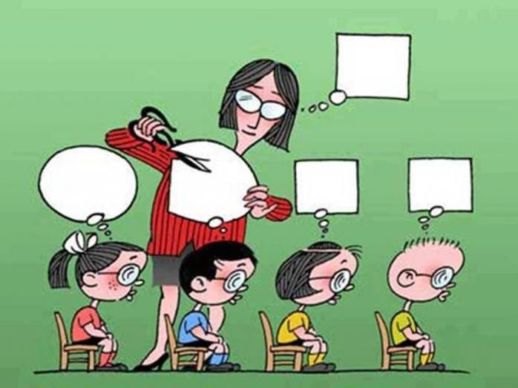
Our Goal
To make sure this is not a picture of future
We want to construct a healthy understanding- ground for a teacher and a student

Slide 6

Our project
A smart class tracking system that helps a learner and a teacher by working on real stats rather than on assumption and GPA.
Our system makes use of data analysis to help students to get better in their respective domains and also helps the teacher in improving his teaching methodology.
Notes:
Our system makes use of data analysis to help students to get better in their respective domains and also helps the teacher in improving his teaching methodology.
You a teacher us we students

Slide 7
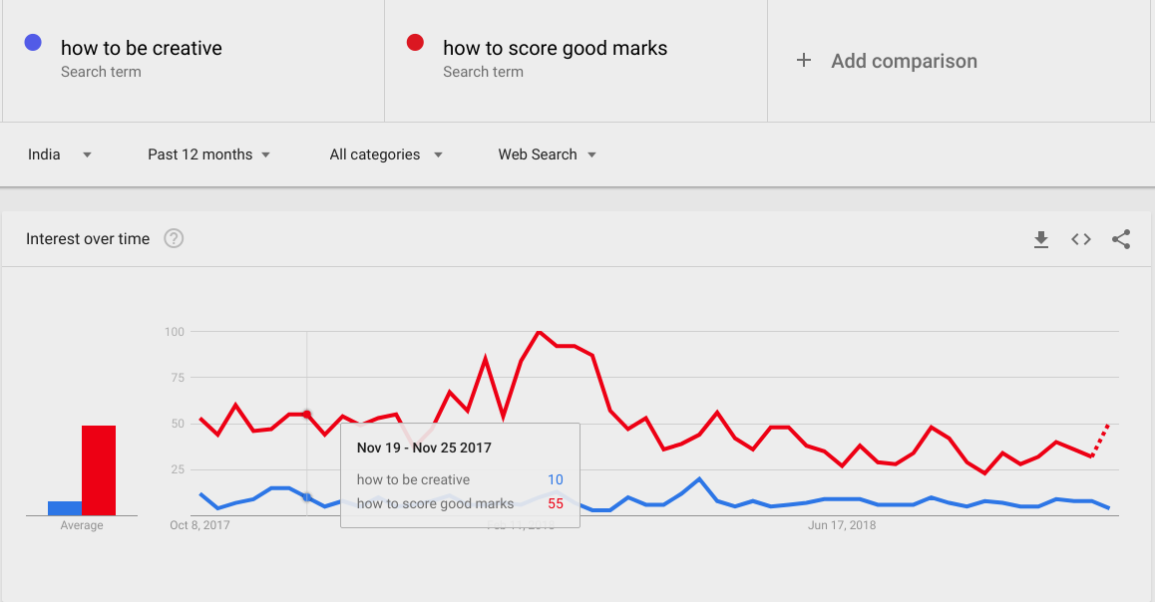
Some facts from present
Notes:
Its not about why scoring marks still a priority for most its about why being creative is not.
Comm reason

Slide 8
But we will make a difference !

Slide 9
Scope
We will use data-analysis to establish relations among a student’s over the time marks, attendance, co-curricular activities and extra achievements.
We are also making a forum where teachers over the network can interact and share their experience, tips, and can even ask for some input on specific topics.
Another teacher - student forum to discuss any idea or query will be made.
Finally an adaptable interface with a robust backend will mark the completion of the project.

Slide 10
Functional requirements
User (teacher) signup/login form
User can use excel/csv etc. to input the records in the database
A dashboard where the teacher can view stats of the students or whole class for each of his/her course
Teacher will be able to analyze students results Results = exam/quiz marks + attendance + co-curricular activities +extra achievements
Professor can analyze TA’s performance as well
Professor will be able to send emails to selected students

Slide 11
7. In the stats above mentioned, teacher will be able to store following student data in the Database:
i) Marks/Grades ii) Attendance iii)Co-Curricular activities if any
- Exam marks
- Assignment marks
- Quiz marks etc.
- Detailed project contribution
iv) Extra achievements like winning in Hackathons, online coding competitions, etc.
v)Class participation
vi)Bonus marks
8. Professor can compare attendance of students with their performance which serves as another feedback for him/her.
9. The analytics part focuses on identifying students who really needs counselling without any stereotyping
Notes:
Graph drops

Slide 12
10.There will be a forum for teachers in which they can discuss about various courses, best resources and teaching methods etc.
11. There will a feature of feedback form i.e. professor can generate feedback forms and roll-out to students.
12. Student login/signup
13. There will be another forum in which students will interact with the professors and ask their doubts.
Notes:
Graph drops

Slide 13
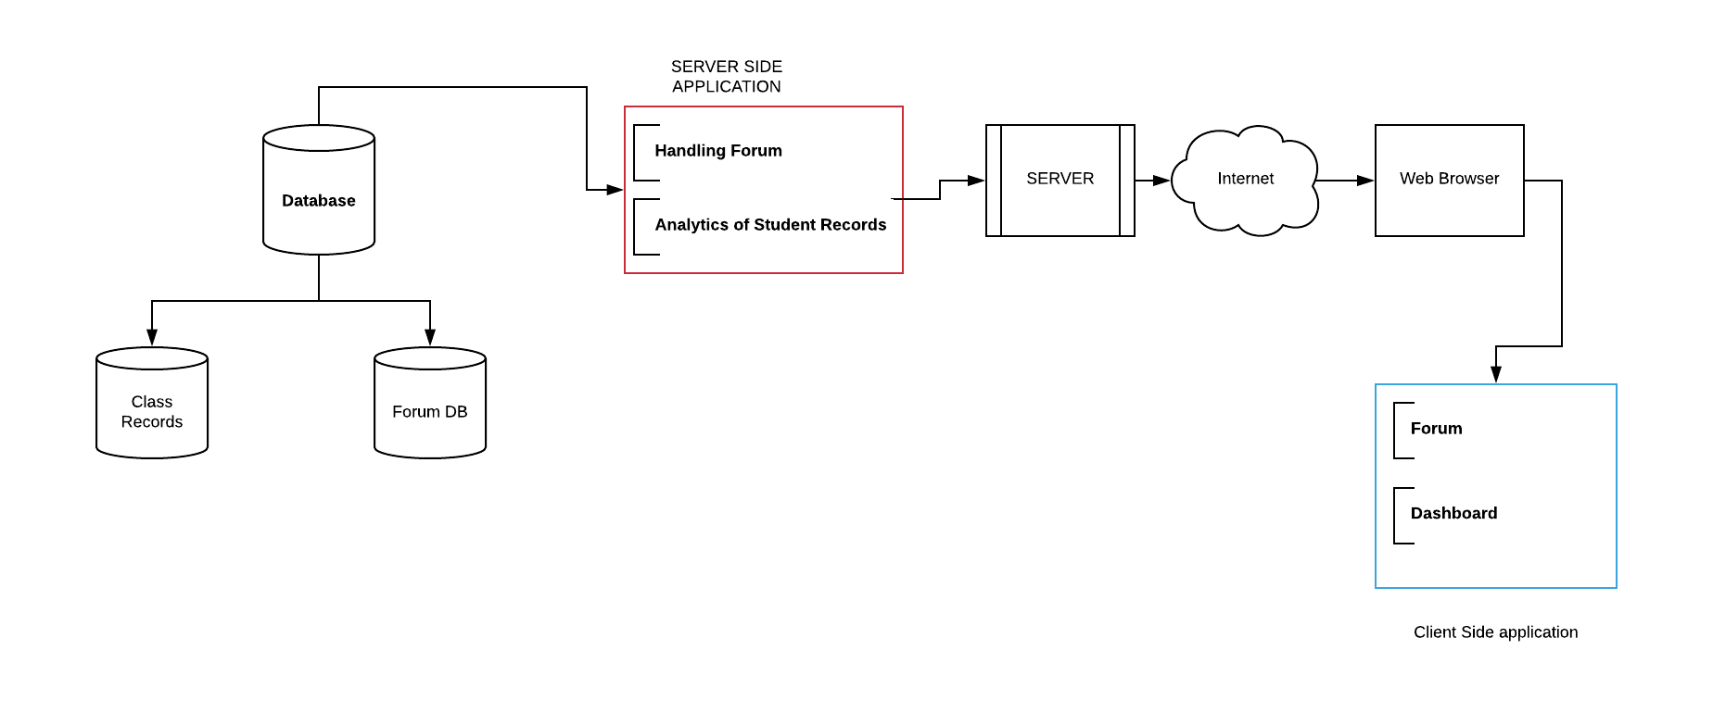
System Architecture
Loc]al host

Slide 14
How do we Handle it.
What’s Novel here?
Notes:
Tell abut the project

Slide 15
With care
Providing anonymity with feedback - no offence
By establishing a community support to help you
Notes:
We know how difficult it is to swallow feedback.with our project we provide anonymity with feedback
By saving your class time
Providing anonymity with feedback - no offence --
Better judgement by adding more input features - extra activities ----
By establishing a community to help you - forum --
Complete package with other features example - mailing, handy dashboard with intuitive graphs, checklist etc.

Slide 16
With credibility
An app for the teachers, by the teachers
Notes:
By working on/with different proven data analysis algorithms taking inputs directly/indirectly(social media) from teachers worldwide
We know how option confusion makes life tough!
And hence we don’t show you any out of hendreds of random graphs
But try to find what you need to know -- may be comparison from other persons past data
Which extra activities you should focus upon

Slide 17
Backend - Python
Web framework - Django
Frontend- HTML/ CSS/ Javascript / Bootstrap
Data analytics and graph plotting - python libraries
D3 js
Database - Mysql
Technologies

Slide 18
Testing & quality assurance
People need to understand how rare or frequent your examples are.
Pick 1 or 2 statistics and make them as concrete as possible. Stats are generally not sticky, but here are a few tactics:
Relate Deliver data within the context of a story you’ve already told
Compare Make big numbers digestible by putting them in the context of something familiar
Unit Testing
Integration Testing
Performance Testing
Functionality Testing
QUALITY ASSURANCE:
1. Website response time will be tested several times after modifications to increase performance.
2. The data analysis part will be done several times to increase the usability of web-app.

Slide 19
Milestones
29 th
10 th
25th
Basic UI and Database architecture
Work on data analytics part
october |  |  |  | November
Forum completion
Complete integration

Slide 20
Thank You !
Notes:
Graph drops

